Slide 1
Cybersecurity for Small Business
the fundamentals
Notes:
Presenter introduction
No matter the size of your company or organization, cybersecurity is a crucial element for continued success. This “Cybersecurity for Small Business: the fundamentals” presentation can be used to share the “how to’s” of cybersecurity as recommended by NIST, the National Institute of Standards and Technology. You, your team, your company or community group will learn the steps for understanding cybersecurity risks and the steps to mitigate them. Your particular industry may have additional and related cybersecurity, regulatory and privacy recommendations, so as a best practice, the information that follows is intended to be customizable, flexible and non-regulatory.
This material is also intended for organizations without a staff member who acts as a dedicated Chief Information Officer (CIO) or risk executive. For those organizations of sufficient maturity/size that have these resources, please refer as well to NIST Special Publication 800-39 “Managing Information Risk: Organization, Mission and Information System View,” in particular the “FARM” (Frame, Assess, Respond and Monitor) process for decision-making. https://doi.org/10.6028/NIST.SP.800-39
While many elements related to cybersecurity are technical, the goal of today’s presentation is to give you a plan of action. No one knows your business as well as you do and no one can start the process for ensuring your business is protected and resilient in the face of non-stop threats from cyber-related harm, whether accidental, criminal, or malicious.
(This content is non-regulatory, but represents road-tested advice from technical experts and people just like you.)

Slide 2

Why Cybersecurity Matters for your Small Business
Notes:
In the small business community, some may think if you are really small, no cybercriminal would ever attack you. You might think, “I have relatively little of value, why would anyone choose me (us) to target.” Or perhaps even worse, that cybersecurity is a problem only a company with a technical staff can address. Cybersecurity is an important concern to every organization, large or small. In fact, the smaller your organization, the more vulnerable you may be. According to the Verizon 2018 Data Breach Investigations Report, small businesses are 58% of data breach victims. (definition: a data breach is a security incident when sensitive, protected data is lost, shared, accessed, copied, stolen, etc.). Unlike the breaches impacting large, publicly traded companies, when a small business is hit with a breach, it may not become public knowledge or get reported in the local news. But the impact can be devastating. Take a moment and consider what you would feel if you found your financial system was hacked and you’d lost money, perhaps all your operating funds. Or if your customer data was lost and you couldn’t recover sales information or the leads you were in the process of managing. What if your business couldn’t recover from the lost money, information or reputation?
Some common threats for small businesses include ransomware, a particular form of malicious software, that causes computers to be locked up by a criminal hoping to get you to pay, literally a ransom, to restore your access to your own data. Ransomware is often introduced to your environment by otherwise friendly services like e-mail.
Other problems could include hackers using your network to piggyback that access into larger, more secure systems, betraying the trust your organization has created. Imagine if you had a partnership with a larger company, where you were providing some specialized product or service. Now imagine if your lack of secured systems or training had allowed a threat to compromise not only you but your partner.
By viewing or participating in this presentation, we hope to help you become better informed of common cybersecurity issues for small businesses and methods and systems you can use to improve your security posture and reduce your risk of being victimized. You’ll also become familiar with resources you can find to keep learning about this topic and organizations that stand ready to assist you, whether from government (state, local and federal) or non-profits.
Do not feel you can’t address this or the problem is someone else’s. But if you learn enough to decide that you need professional help in managing your cybersecurity program, that is also a good outcome to this material.

Slide 3
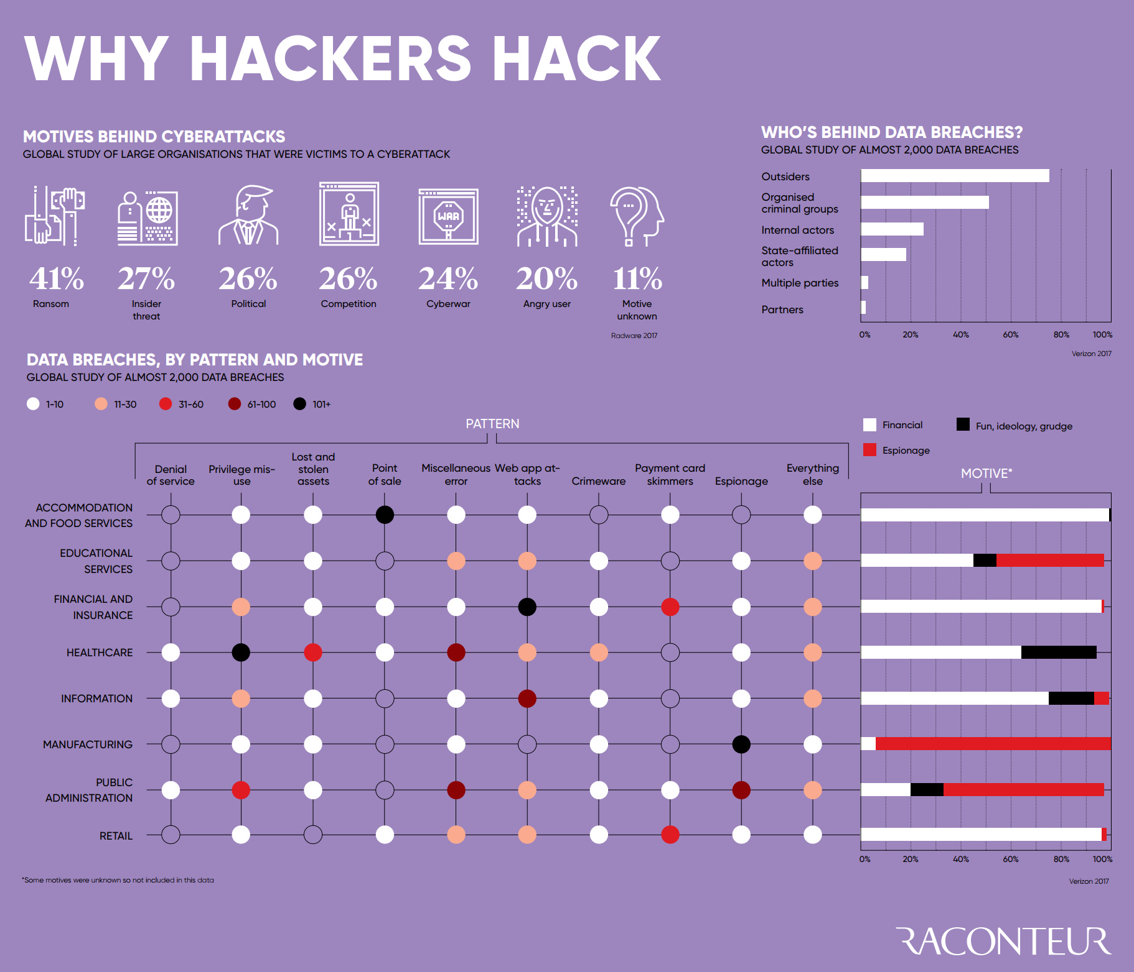
Why Hackers Hack
Source: Raconteur: http://www.visualcapitalist.com/hackers-hack-motives-behind-cyberattacks/
Notes:
Understanding why cybercriminals do what they do, a whopping 41 % of the motives behind recent attacks was to demand a ransom. Yet another 27 % are due to insiders, an employee stealing or selling proprietary information like customer lists or product designs. It’s usually an outsider in an organized criminal syndicate, attacking large numbers of targets in hopes of successfully breaching your defenses or encrypting your data for ransom. All industry sectors are vulnerable as this chart indicates.

Slide 4
What You’ll Learn
Cybersecurity basics
Risk management
Cybersecurity Framework
Small business cybersecurity resources
More Information
Throughout this presentation, keep an eye out for these boxes which will direct you to publications containing definitions, examples and more related to the topic on the slide.
Notes:
When we consider that the most common business in the United States is a small business, we can understand the importance of addressing the cybersecurity needs of this business segment. 75 % of US employers are micro-businesses with fewer than 9 employees, a remarkable 3.8 million micro-businesses. https://www.sba.gov/sites/default/files/508FINALAug17Microbusiness.pdf These employers likely do not have dedicated security staff but they have the same need to be cyber-aware and safe as any large enterprise organization. It’s for this type of organization that this presentation has been created.
By reading or reviewing this material, a small business owner or employee will learn about the basic concepts of cybersecurity and the topics most frequently of concern to small business owners.
When small businesses around the US were asked about the issues they are most concerned about, they mentioned* phishing schemes, ransomware attacks, financial fraud and tech support scams, as well as cybersecurity basics. Small business owners also wanted information about how to protect their company’s mobile devices, and a list of questions they should ask vendors to ensure their systems are secure.
Every small business wants to minimize the risks that might harm their ability to continue operating, cost them money or damage their company brand. Understanding cybersecurity and taking action is a best practice to mitigate risks and provide a way to recover from unanticipated threats, cyber or otherwise.
You will learn about the NIST Cybersecurity Framework, which is a flexible and understandable model that helps an organization prioritize their approach to developing a cybersecurity plan that works for them.
We’ll also include tips and advice, as well as recommendations for other materials that you can use to educate yourself and your team on a variety of related topics, like the best way to use mobile devices, and accessing networks while on the road.
Lastly, we’ll share a variety of resources from across the federal government and other partners that we think you’ll find useful as you build your plans and create policies and procedures to become safer from cybersecurity threats.
*https://www.ftc.gov/reports/engage-connect-protect-ftcs-projects-plans-foster-small-business-cybersecurity-federal-trade

Slide 5

Cybersecurity Basics
Cybersecurity:
protecting electronic devices and associated data and information
Notes:
Defining cybersecurity can be difficult and you may find some definitions that fit your business and industry better than others. At NIST, one definition in use is the prevention of damage to, protection of, and restoration of computers, electronic communications systems, electronic communications services, wire communication, and electronic communication, including information contained therein, to ensure its availability, integrity, authentication, confidentiality, and nonrepudiation. This comes from a Glossary on the NIST website: : https://csrc.nist.gov/Glossary/?term=3817#AlphaIndexDiv):
Source(s): CNSSI 4009-2015 (NSPD-54/HSPD-23)
In this section of the material, we will review a conceptual model to help you start to consider the elements of your business that are at risk. The goal of your cybersecurity plan should be to protect, not only from criminal activity, but also from inadvertent harm (such as never or rarely backing up your data and then suffering a mishap like an office fire or theft and losing important files and information.)
And the systems we rely upon are increasing complex. Consider your home computing environment: each member of your family may have a computer, a tablet, a phone. You may use in the cloud storage and backup systems. Your digital camera’s memory card has the images of your family vacation or major life events, as well as more mundane but important images. At work, your information is more financially critical but just as complicated if not more so. Customer and employee information including Personally Identifiable Information or PII. Sales information and product design data. Emails about future business plans. The list is endless and varied about what you’ve got to keep safe, reliable and protected.
Whether you are securing the information of your family or that of your business, it requires detailed consideration to remain safe. Not only do we need to remain vigilant but we need to prepare for bad things to happen and plan for ways to recognize a problem and recover from an attack or loss.
Let’s consider real-world examples of cybersecurity nightmares from companies like yours:
A medical transcription company failed to properly design their online portal, allowing patient records to be accessed in the open. https://krebsonsecurity.com/2018/04/transcription-service-leaked-medical-records/
An Alaskan real estate company hit by the “DMA Locker” ransomware. The hackers asked for payment of four bitcoins to decrypt their own files. (As of June 2019, one bitcoin is approximately $9,500). https://www.grahamcluley.com/firms-piggyback-ransomware-attacks-profit/
An accountant was hit by a keystroke logger malware infection causing his clients’ tax returns to be filed fraudulently. https://krebsonsecurity.com/2018/04/when-identity-thieves-hack-your-accountant/
A church finance person’s email was hacked, leading to ½ million dollars being stolen from the church https://news.adventist.org/en/all-news/news/go/2014-04-08/new-details-released-in-cyber-attack-that-defrauded-adventist-church-of-half-a-million-us-dollars/
Another scary aspect of small business cybersecurity is you may not even been aware there is malware on your system or data has already been breached: a nationwide survey shows 60 % SMB have been victimized but many don’t realize it. https://www.nationwide.com/about-us/100917-cyber-security.jsp
Take a moment and think about all the devices, systems and data you are working with in your small business.

Slide 6
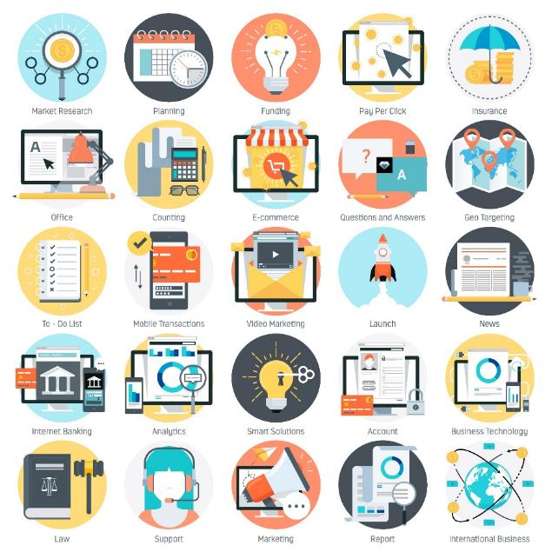
Complexity of a modern small business
Email
Mobile devices
Corporate website
Social media
Ecommerce systems
Online banking
BYOD and office policy
Network management
Backup and remote access
Notes:
Take a moment to consider how complex a modern small business might be. Your grandparents or even your parent’s generation could successfully manage a business with little more than paper, possibly a computer and a telephone connection.
Today, the expectations of a business, small or large, are far more complex. Just to get your business started, you created some form of technological presence, setting up email, websites, and ecommerce. You want it to be easy to purchase your goods or for customers to pay their bills, so you’ve likely set up online payment and banking systems. You’ve integrated them with customer data management systems and given some of your employees access to them.
As your business grows, so does the data you are managing. Email records, employee information, customer data and sales systems (inventory, history), tax information, licensing and permits.
Every small business has need to consider the various systems and devices they are managing, whether they intended to or not, that enable their business to run efficiently. You use email to communicate with employees and customers and vendors. What system will you use and how will you manage it? Will you give access to trusted employees?
Your employees have phones and laptop computers, whether their own or company-provided. Can they use the office network or do you restrict access? Do you provide virtual private networks and remote access to systems? Who sets policy and decides what’s safe or who should have access and who shouldn’t? If an employee wanted to print a personal document, would you allow it? What security risk might accompany that simple act?
Does your business have an online presence such as a website or social media accounts? Who manages the account and how do they secure it? Are they reusing passwords or accessing these accounts on insecure systems? Was the website originally designed with security in mind? Have you added capabilities such as online ordering or inventory management that could be attractive to criminals?
Who has access to your company’s banking? Do you have policies in place to prevent malicious use via social engineering? Are your employees trained on how to recognize possible fraud? If someone sent an email on a Friday afternoon insisting on an emergency wire transfer of funds on your behalf, what mechanism do you have to identify a real request from a fake one?
What is your backup policy for company data and your employee’s devices? Do you practice backing up and testing your backups? Are you utilizing cloud-based storage and services?
How do you select your vendors and what questions do you ask about their cybersecurity practices? You can see this complex environment can’t be secured just by setting a policy or trying a one-size-fits-all approach. How to begin?
Let’s begin understanding the key objectives to manage your cybersecurity risk and develop a plan.

Slide 7
Cybersecurity Objectives
More
NIST Special Publication 800-12, revision 1
An Introduction to Information Security section 1.4
confidentiality
integrity
availability
Notes:
One definition of information security is “the protection of information and systems from unauthorized access, use, disclosure, disruption, modification, or destruction in order to provide confidentiality, integrity, and availability. The careful implementation of information security controls is vital to protecting an organization’s information assets as well as its reputation, legal position, personnel, and other tangible or intangible assets.”* At NIST, the three tiers of Confidentiality, Integrity and Availability are addressed in more detail in our Special Publication “An Introduction to Information Security”. You will find a link to this document on the worksheet titled NIST Resources found at the NIST Small Business Corner. (url is also below)
Looking at this three tier set of objectives, what do they mean. Confidentiality means that what is restricted information remains restricted and the controls to maintain that are upheld and secured.
Integrity considerations include both data and system integrity and the need to guard against someone modifying or destroying them or causing concern about reliability.
Availability considerations refer to the need for you to get to your data and information without disruption.
Your business objectives are typically supported by a focus on all of these three areas but to differing degrees. (An e-commerce organization may be very focused on availability, a small healthcare organization focused more on confidentiality of patient info).
*Resource: https://doi.org/10.6028/NIST.SP.800-12r1 “An Introduction to Information Security”

Slide 8
Confidentiality
Example:
Criminal steals customers’ usernames, passwords, or credit card information
confidentiality
Protecting information from unauthorized access and disclosure
Notes:
Confidentiality is often defined as “Preserving authorized restrictions on information access and disclosure, including means for protecting personal privacy and proprietary information.” Depending on the sort of business you operate, you may also have regulatory requirements to meet on protecting and managing private information from unauthorized access and disclosure.
When we say Confidentiality, it’s about storing, sending, handling information – it needs to be protected. You need to ensure that the trust given to you by customers and business partners is met by procedures to protect the valuable information you are managing.

Slide 9
Integrity
Protecting information from unauthorized modification
integrity
Example:
Someone alters payroll information or a proposed product design
Notes:
Let’s define “Integrity” as it refers to our data = Guarding against improper information modification or destruction and ensuring information non-repudiation and authenticity.
There are two kinds of integrity to consider, Data and System:
Data Integrity – The property that data has not been altered in an unauthorized manner. Data integrity covers data in storage, during processing, and while in transit. This might imply you test your backups to ensure that you are recording your information accurately.
System Integrity – The quality that a system has when it performs its intended function in an unimpaired manner, free from unauthorized manipulation of the system, whether intentional or accidental.
Here you might ensure someone doesn’t have access they shouldn’t, like a student shouldn’t be able to get into their teacher’s gradebook and change their D to an A. That might be data integrity.
When we say integrity, it means you’re making sure the information you’ve stored remains accurate. E.g., relying upon historic sales information.

Slide 10
Availability
Example:
Your customers are unable to access your online services
Preventing disruption in how information is accessed
availability
Notes:
Availability – Ensuring timely and reliable access to and use of information. You need your website to be up, your ordering system active, your inventory and shipping systems working 24/7. Concerns about availability may cause you to select equipment with a low-repair reputation because you can’t risk any downtime. Imagine if a cybercriminal could shut off your systems?
If your business can’t pull information, process a sale, place an order, how long will you stay in business?
If you want to learn more about cyber impact to confidentiality, integrity and availability, please refer to:
https://doi.org/10.6028/NIST.SP.800-12r1

Slide 11
Small Business, Big Impact
Why put your already limited resources into preparing for and protecting against cybersecurity attacks?
Vulnerability
Business Costs
Reputation
Attackers can see small businesses as easy targets
Attacks can be extremely costly and threaten the viability of your business
Customers and employees expect and trust you to keep their information secure
Notes:
Small businesses don’t always realize that, despite their smaller size and lower profile, they could be a much bigger target to cybercriminals than a bigger organization. There are three reasons why your business could be attractive to bad actors and why you need to invest the time and resources to prepare and protect against an attack:
Vulnerability: first, small businesses may lack the staff and resources of larger organizations to invest in their cybersecurity systems, and as a result, just might be easier to hack. Second, many attacks are automated infected emails going to hundreds of thousands or millions of addresses or via intrusions on web addresses all over the world. Sometimes, small businesses just get swept up in a broader attack vector. Third, small businesses might not detect malware or an intrusion as readily as a larger company and this could allow a threat to remain on a system for a much longer time, not only damaging the smaller company but possibly allowing the cybercriminal to stage attacks using the small business as a platform.
Business costs: It’s likely to be more painful for a smaller company to address a cybersecurity attack and recover than for a larger company. There can be significant costs to recover from common cyber attacks. And if the small business loses intellectual property in the process, it’s possible that the business will never be able to fully recover. Your business might not have cyber insurance or consultants you can leverage. Dealing with the aftermath of a cybersecurity attack has a steep and painful learning curve to climb during a crisis.
Reputation: this is probably the scariest element for a small business. If you lose the trust of your customers, how do you come back from that? Depending on the nature of your attack, you may have regulatory and legal concerns such as a need to notify customers or patients or vendors of the breach or loss. What if this information gets shared on your local news?

Slide 12

Cybersecurity Basics Resources
Want more details?
For a primer on cybersecurity basics with a focus on small businesses, check out NISTIR 7621, revision 1.
More
NIST Interagency Report 7621, revision 1
Small Business Information Security: The Fundamentals
Section 1: Background: What is Information Security and Cybersecurity?
Notes:
https://doi.org/10.6028/NIST.IR.7621r1
This NIST Interagency Report (or NISTIR) is available, along with other NIST reports online.

Slide 13

Cybersecurity Threats
Phishing Attacks
Ransomware
Hacking
Imposter Scams
Environmental events
More
NIST Interagency Report 7621, revision 1 | Small Business Information Security: The Fundamentals, section 2.1
Notes:
In the previous section called Cybersecurity Basics, we talked about the big picture of why cybersecurity is relevant to your world as a small business person. Understanding some of the most typical cybersecurity threats will also be useful as you consider the particulars of your business and your information systems. In this section, we will learn about specific threat types you may encounter or hear about in the news.
Examples:
Phishing - On July 6th, 2017, over 3,000 businesses were targeted with an email scam that stated that a UPS shipment was being delayed. When recipients clicked the link, however, they were taken to a page that installed and deployed malware.
Ransomware – WannaCry was one of the most devastating ransomware attacks in history, affecting several hundred thousand machines and crippling banks, law enforcement agencies, and other infrastructure.
Hacking – hacker breached Copenhagen's city bikes network— deleting the organization's entire database, disabling the public's access to bicycles over a weekend.
Imposter Scam - Some scammers call and claim to be to be “tech support”. They say they’ve detected viruses or other malware on your computer and will ask you to give them remote access to your computer.
Environmental events – fires and floods.
Also: cloud storage threats, compromised stolen devices.
Motivation of attackers - revenge for being fired, money, espionage, desire for notoriety.
https://doi.org/10.6028/NIST.IR.7621r1
https://www.ftc.gov/tips-advice/business-center/small-businesses

Slide 14
Phishing Attacks
Example:
An email about a delayed shipment causes you to click a link and download malware to your network.
Social engineering attack involving trickery
Designed to gain access to systems or steal data
Targeted phishing is “spear phishing”
Variants include “vishing” – attacks by telephone and “smishing” those using SMS or text
Notes:
In a phishing attack, you should image the word “phish” is spelled with “f” as in going fishing. There is bait used to trick you into jumping in the net or biting on their hook.
An email pretending to be from your bank with instructions to share your login information.
An offer from a prince to share untold millions in unclaimed gold.
These are common phishing attacks.
Now imagine if the email is addressed to the chief financial officer of your firm. The name used is correct as is his/her title. Perhaps they pretend to be from your company’s bank and even use the name of your trusted loan officer. This fake email is a “spear phishing attack”. So known by the precise methodology used to get past your normal screening system and to increase the chance you will believe their instructions.
Protect your organization by remaining aware of these attacks and training staff and yourself on how to recognize common traits of a phishing attack. There is a sense of trust (they use your name or some element of information to establish a connection); they use brands, logos and links that look correct but are misleading or false; they have a sense of urgency compelling you to take action or something bad will occur; and some have actual people ready to respond if you make the mistake of requesting further information from them.

Slide 15
Ransomware
Example:
WannaCry was one of the most devastating ransomware attacks in history, affecting several hundred thousand machines and crippling banks, law enforcement agencies, and other infrastructure.
Type of software with malicious intent and a threat to harm your data
The author or distributor requires a ransom to undo the damage
No guarantee the ransom payment will work
Ransom often needs to be paid in cryptocurrency
Notes:
Most of you will have heard the term WannaCry, an evocative name but also one of the biggest, most widespread ransomware attack of recent history. In general ransomware is software that can encrypt or lock your data behind a secret key or passcode. Without that code, your data and network are inaccessible and you are literally frozen out of your own files and information. Worse, the malware (malicious software) author will include a threat, often a short window of time by which you must pay them a ransom and you will get your information unlocked. Failure to meet their demands will cause them to lock or destroy your information.
The decision whether or not to pay the ransom is very difficult. Sometimes there are tools available from security vendors that can undo the ransomware but often there is no available remedy and many will decide to pay. On some occasions the malware is so poorly crafted that the damage cannot be undone, even if you’ve paid. A study in 2018 found that for those who paid, only about half found the tools given them by the malware author worked and the other half couldn’t get their data back.* Cybercriminals do not give money back guarantees for their work.
*https://www.bleepingcomputer.com/news/security/only-half-of-those-who-paid-a-ransomware-were-able-to-recover-their-data/

Slide 16
Hacking
Example:
Newspaper kiosk’s point-of-sale system was hacked; malware installed. Every customer’s credit card information was sent to criminals.
Unauthorized access to systems and information
Website attack such as DDOS
Access denied to authorized users
Stolen funds or intellectual property
Notes:
Although the term hacking has connotations for good, here we will focus on the malicious forms of hacking. When someone stages an attack on your network or the systems you use, we can call this hacking. Typically the hacking attack will occur without anyone ever setting foot in your office or on your property. They will utilize access via the internet or on your own network to go after some aspect of your environment.
A DDOS or distributed denial of service attack often means they will overwhelm your website or web address with internet traffic, blocking legitimate traffic and taking your website down. The attack is shared across multiple attack points, hence the word “distributed” in the name. The attackers may be using a botnet, or network of infected computers acting upon their command to stage their flow of traffic against you.
DDOS attacks are common and impact business, governments large and small and individuals.
As our business environments increase in complexity, we also need to guard against previously protected systems and devices that have added network capabilities. Consider the increasing popularity of the Internet of Things with network connected refrigerators, thermostats, even lightbulbs. Every advantage these devices provide us carries an additional cost in needing protection from cybersecurity risks. Can you update these devices and how do you control who can send those update messages? Could a hacker communicate with your thermostat via your own wireless network? What about your office printer and fax machine? Do they store the images they’ve sent and could someone access that information without permission?
Hacking can also occur when a trusted employee or visitor to our physical environment abuses that trust to illegally access other areas of the business. We must safeguard our systems by using controls such as passwords and checking access records to ensure our systems are protected both from within and without.

Slide 17
Imposter Scams
Example:
IRS scams – You receive a phone call claiming to be the IRS, reporting you owe money and need to pay or else get hit with a fine.
Someone “official” calls or emails to report a crisis situation
They represent the IRS, a bank, the lottery or technical support
There will be a sense of urgency and a dire penalty or loss if you don’t act
Notes:
You may have received, both at work and at home, a telephone call from someone claiming to work for a big computer company. They have “noticed viruses on your computer” and offer to help you remove them and repair the damage, of course for a fee.
Or perhaps you have been called by someone purporting to be with the Internal Revenue Service and you have made an error on your taxes and must pay a fine right away or they will file a lawsuit against you.
There are also more personal scams where people target the elderly and claim to be their grandchild and in trouble, needing funds wired right away.
Be careful and alert whenever you receive an unanticipated phone call such as these. The IRS and any government agency will not communicate with you by telephone.
The Federal Trade Commission or FTC has useful resource material on these scams and others. Go to https://www.consumer.ftc.gov/ for more information.

Slide 18
Environmental Threats
Example:
Ellicott City flooding wiped out businesses and their computers
Natural threats such as fire, earthquake, flood can cause harm to computers or disrupt business access
Recovery efforts attract scams such as financial fraud
Downtime can lose customers, clients who can’t wait
Notes:
If your business is hit by a natural disaster, you may be harmed by physical loss of your computers and other storage and business devices or by the inability to communicate with staff, customers and vendors. If your physical plant burns down, you need time to rebuild but if you lose company records, financial data, banking instructions and more, how will you recover from that? Having a plan for cybersecurity that considers the physical security of your business and home is a best practice.
Consider using cloud-based services and storage if appropriate to your business model; when creating back-ups and storing data, have a system that includes off-site physical storage as well. Having duplicate storage with information on inventory can help with the recovery process as well, or in communications with insurers and the government.

Slide 19

Elements of Risk
What are the threats?
What are the vulnerabilities?
What is the likelihood of a threat exploiting a vulnerability?
What would be the impact of this to your business?
More
NIST Special Publication 800-30, revision 1
Guide for Conducting Risk Assessments, section 2.3.1
Notes:
We’ve discussed why a small business is at risk of cyber harm and you’ve learned about various types of specific threats. By now, you see that your small business is (potentially) a target. To manage your risk, you will want to evaluate not only the particular threats and vulnerabilities you must guard against but focus on the threats with the biggest potential impact to you to know where to prioritize your cybersecurity efforts.
In this section you will understand what are your business’ assets, what is most valuable and this will help you determine where to prioritize your effort and spending.
Note to presenter - This following slides present great opportunities to engage the participants in dialogue to facilitate discussion about the elements of risk—particularly as they elements relate to their businesses.
Example:– Using the example of the flooding in Ellicott City, Maryland, which included terrible flooding in the central business district. Although the likelihood of a “so-called” 100 year flood was low and rare, it happened not just once but twice. The impact was very high, in fact catastrophic for some small business owners. Discuss what possible events might cause a big impact like that whether a flood or a power grid outage or something else.
What are the threats?
What are the vulnerabilities?
What is the likelihood of a threat exploiting a vulnerability?
What would be the impact of this to your business?
Risk is a function of threats, vulnerabilities, the likelihood of an event, and the potential impact such an event would have to the business. Most of us make risk-based decisions every day. While driving to work, we assess threats and vulnerabilities such as the weather and local traffic conditions, the skill of other drivers on the road, and the safety features and reliability of the vehicle we drive. (NISTIR 7621, revision 1 – section 2) https://doi.org/10.6028/NIST.IR.7621r1
In this section, we will talk more in detail about the concept of risk management which later leads into the use of the NIST Cybersecurity Framework, a flexible and easy to use approach to creating your business’s plan for addressing cybersecurity threats within five key Functions.

Slide 20
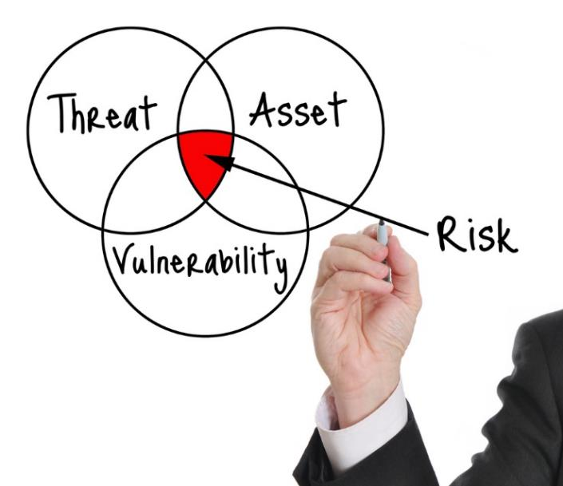
What are you protecting?
To practice cybersecurity risk management, you can start with these steps:
Identify your business’ assets
Identify the value of these assets
Document the impact to your business of loss or damage to the assets
Identify likelihood of loss or harm
Prioritize your mitigation activities accordingly
More
NIST Interagency Report 7621, revision 1
Small Business Information Security: The Fundamentals, section 2.2
Notes:
What are you protecting? We can’t create a structured protection plan without an understanding of your “assets” – your assets are more than information, it’s your people, processes, technology, and more. Begin by thinking about the most crucial elements to your business. Identify what assets your business needs to succeed, what you receive from partners, what you manage, what you share, what you need to report and so forth.
In this section, we will follow a 5-step process to consider how valuable and critical each asset is and develop an inventory. How are they vulnerable and how will you protect them? By understanding what is most valuable and what has the most potential impact to your business continuity, you can develop a prioritized plan.
Reference materials: NIST Publication Small Business Information Security: The Fundamentals
https://doi.org/10.6028/NIST.IR.7621r1

Slide 21
1. Identify Your Business Assets
List the types of information, processes, important people and technology your business relies upon
Also consider critical business processes like sales and budgeting.
Customer info
Key employees
Banking info
Manufacturing Process
Proprietary technology
Notes:
We start by identifying the assets most important to your business. Remember that assets can include information, people, processes, and technology—anything that is important to your business’ operation.
To get more concrete about information, let’s consider some common types of information. You probably have lists of customers and share those lists with employees in your environment such as sales and fulfillment or service providers. There are lots of related information with each customer in their account.
List important technology that stores or processes that information—including 3rd party providers like cloud storage, email provider, web hosting provider, etc.
Don’t forget to include business processes that your business depends on, such as payroll, customer engagement, online payment processing, etc. And consider critical employees or roles in your business.
The next slide shows an example.

Slide 22
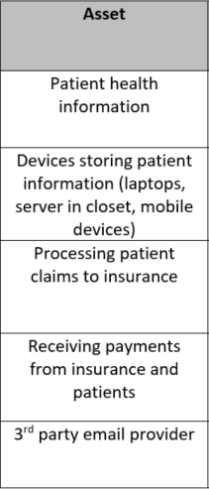
1. Identify Your Business Assets on the Worksheet (cont.)
In column 1 of the worksheet, list the assets (e.g., information, people, processes, or technology) that are most important to your business
Add more rows, if needed
Notes:
This is a short list representing a small medical provider.
Note that this list is incomplete and serves only as an example. A medical provider may have many more (and different) assets than those listed here.

Slide 23
2. Identify the Value of the Assets
Go through each asset type you identified and ask these questions:
What would happen to my business if this asset was made public?
What would happen to my business if this asset was damaged or inaccurate?
What would happen to my business if I/my customers couldn’t access this asset?
Notes:
Determining the value of your business assets is an important step in your cybersecurity planning. Value is a relative term; you might associate a range to these assets such as high, medium and low value. This exercise is to help you consider where to prioritize your efforts to protect your business assets. Ask yourself the following questions to start the process: What would happen to my business if this asset was made public? If the asset was incorrect or changed, somehow? What if the asset became inaccessible for some reason?

Slide 24
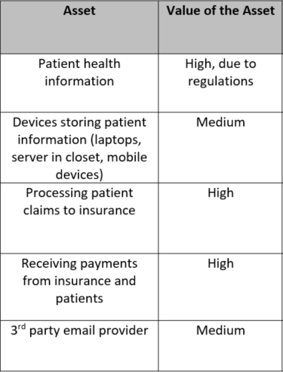
2. Identify the Asset Values on the Worksheet (cont.)
Pick an asset value scale that works for you (e.g., low, medium, high or a numerical range like 1-5)
Notes:
Continuing the example of the small medical provider, this chart shows an asset value rating of low, medium, and high. Choose a rating scale that works best for you.
Note that this is merely an example and may not accurately represent the asset values of a small medical provider.

Slide 25
3. Document the Impact to your Business of Loss/Damage to the Assets
Consider the impact to your business if each asset were lost, damaged, or reduced in value (e.g., intellectual property revealed to competitors)
This impact may differ from the asset value determined in step 2.
Notes:
In step 3 determine the impact (using Low, Medium, or High) to your business if the asset were lost, damaged, or reduced in value.

Slide 26
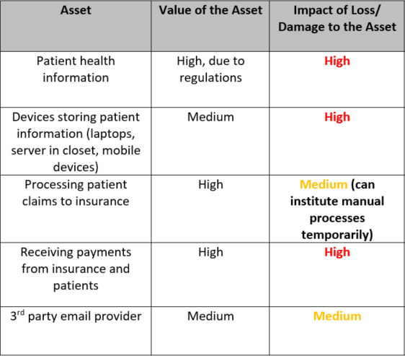
3. Document the Impact to your Business of Loss/Damage to the Assets (cont.)
Pick an impact value scale that works for you (e.g., low, medium, high)
Consider if any business processes have manual backup methods
Notes:
In many cases, this value may be the same as the asset value in Step 2. However, this may not always be the case. A couple examples:
The inherent value of the medical devices in the example above is medium. However the medical provider may determine that compromise of the medical devices and the patient data stored on them can cause harm to patients. He/she determines that the impact is High.
Perhaps there is a business process (e.g., “processing patient claims to insurance”) which is critical to the business’ operation. However, manual processes can be temporarily enabled while the normal business process is re-enabled. Because of this manual backup, the medical provider determines that the impact of the loss of this business process is medium.
Note that this is merely an example and may not accurately represent the asset impacts of a small medical provider.

Slide 27


4. Identify likelihood of loss or damage to the asset
List the threats to each business asset
Evaluate the likelihood that the asset may be lost or damaged by the threat(s)
More
NIST Special Publication 800-30, revision 1
Guide for Conducting Risk Assessments, Appendix G, Likelihood of Occurrence
Notes:
https://doi.org/10.6028/NIST.SP.800-30r1
The previous module discussed common cybersecurity threats, including hacker, ransomware, phishing, etc. List the threats to each of the assets listed.
Once threats to each asset have been identified, try to evaluate the likelihood that the asset may be lost of damaged by the threat(s). This is not an exact determination; reasonable estimates are fine. Follow your instincts and/or consider consulting with a trusted colleague.

Slide 28
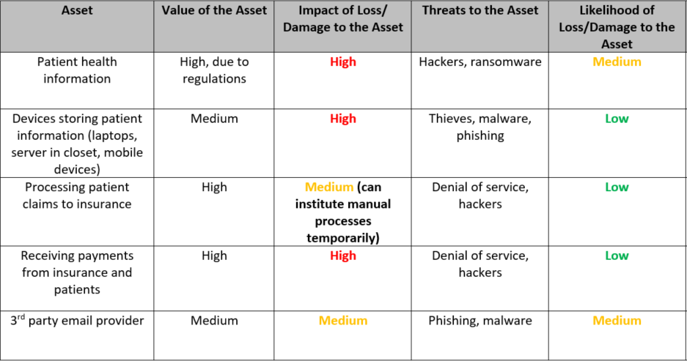
4. Identify likelihood of loss or damage to the asset (cont.)
Notes:
Refer to previous modules to list possible threats to each asset listed.
Then determine the likelihood of the threat damaging the asset or making it unavailable to your business. As before, the example above uses a low, medium, high rating scale. Choose a scale that works best for your business.
Note that this is merely an example and may not accurately represent the threats and likelihood of a small medical provider.

Slide 29
5. Identify Priorities and Potential Solutions
Compare your impact and likelihood scores. Assets with high impact and/or likelihood scores should be assigned top priorities.
Identify your priorities.
Identify potential solutions.
Develop a plan, including funding, to implement the solutions.
Sample Priority Structure
High: Implement immediate resolution.
Medium: Schedule a resolution.
Low: Schedule a resolution.
Notes:
After you have completed the previous worksheet, you will now be able assess risk in a prioritized manner for your business assets. Prioritizing the use of resources in a small business is always tricky, especially for activities that aren’t tied to sales and services but as you’ve seen, risk to small businesses is very real and the time and money you invest in protecting your assets will pay off, in confidence and readiness.
The matrix on the next slide may help in prioritization.

Slide 30
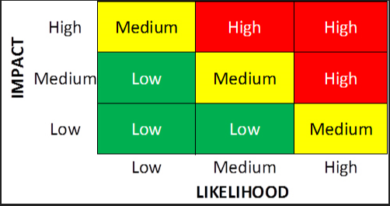
5. Prioritize Assets - Risk Matrix
Notes:
Credit for image: https://www.pivotpointsecurity.com/blog/using-matrix-models-for-risk-assessment/
This matrix takes the impact and likelihood scores from the previous steps as input to determine overall risk prioritization.
Note that this matrix is notional. Business owners should modify the overall risk prioritization as they see fit. He/she may determine that an asset is so valuable that it needs a High risk rating (red colored) even though the likelihood value is low.

Slide 31
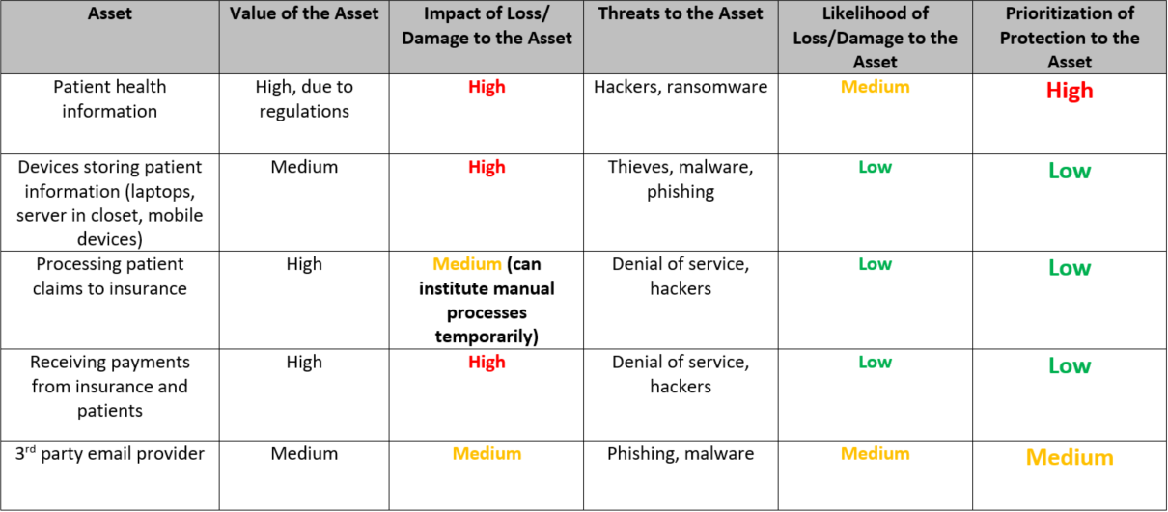
5. Prioritize Asset Protection
Notes:
Refer to the impact and likelihood ratings from previous steps (bold in the example above). For each asset, use the matrix on the previous slide to find the intersection between the impact and likelihood ratings. This is the risk rating and directly impacts resource prioritization. Focusing your time and money on protecting “High” prioritized assets could provide the greatest benefit for your business.
The next module (Cybersecurity Framework) will discuss a variety of cybersecurity activities that can help you identify potential solutions to protect your important business assets.

Slide 32
NIST Cybersecurity Framework (“Framework for Improving Critical Infrastructure Cybersecurity ”)
Provides a continuous process for cybersecurity risk management
For organizations of any size, in any sector, whether they have a cyber risk management program already or not
Has proven useful to a variety of audiences
More
Framework for Improving Critical Infrastructure Cybersecurity version 1.1
Notes:
Now that you have walked through identifying and valuing and prioritizing your business assets, this next section will present time tested activities to protect your assets. You might find activities in this section that will help you.
Have you previously heard of the NIST Cybersecurity Framework? Since 2014, this non-regulatory framework has allowed a rigorous methodology to evolve of assessing risk and developing a plan for all possible outcomes. It’s good to note that the Cybersecurity Framework is the result of extensive public-private sector collaboration, as it has resulted in a flexible mechanism that can be used by all organizations, big or small. It has become a best practice for large corporations and is increasingly recognized as important for small businesses to utilize.
The Cybersecurity Framework offers a variety of options to reduce your vulnerability and therefore the likelihood of impact to your business.
https://nvlpubs.nist.gov/nistpubs/CSWP/NIST.CSWP.04162018.pdf (Version 1.1)

Slide 33
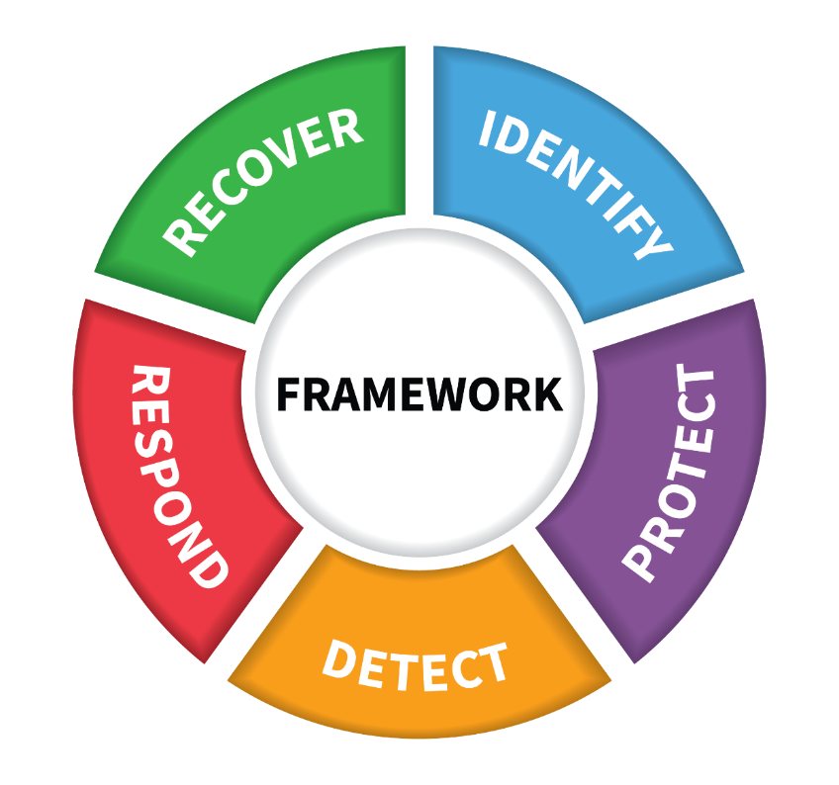
Cybersecurity Framework Functions
Credit: N. Hanacek/NIST
Notes:
The NIST Cybersecurity Framework provides a basic and understandable language of five key Functions– Identify, Protect, Detect, Respond, Recover – for managing risk iteratively over time.
https://nvlpubs.nist.gov/nistpubs/CSWP/NIST.CSWP.04162018.pdf (Version 1.1)
Why is a dynamic, iterative risk management approach recommended?
More vulnerabilities are discovered every day, threats evolve, probability can change, impact/consequence can change. With these four risk factors in continual motion, you too will need to re-assess your risk, so you can re-visit and re-fine your risk decisions over time. With those concerns in mind, using the framework is an ideal methodology to allow for this level of iteration and responsiveness to our environment.
Let’s spend time on each of the five Functions that make up the framework. Within each Function are additional levels, referred to as Categories. These Categories can be thought of as groupings of similar cybersecurity activities. And Categories contain Subcategories which are discrete cybersecurity outcomes that a business may want to achieve. Some of these cybersecurity outcomes will be more important to a business than other cybersecurity outcomes. This importance often depends on whether the cybersecurity outcome helps the business achieve business/mission objectives or meet regulatory requirements. On the following slides, we’ll spend some time looking at each of the 5 Functions as well as some of the Subcategory cybersecurity outcomes that may help your business achieve its business objectives and/or meet regulatory requirements.
---

Slide 34
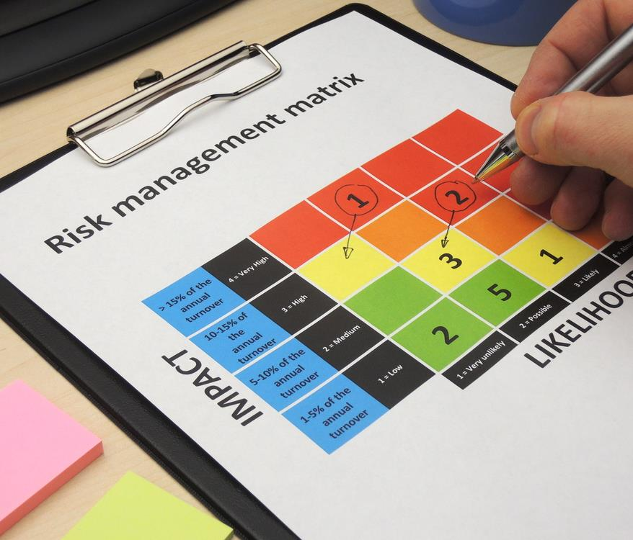
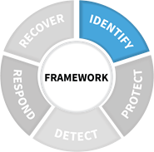
Identify
Develop organizational understanding to manage cybersecurity risk to systems, assets, data, and capabilities.
Notes:
Activities in the Identify Function are about identifying what is most important to your business…what needs to be protected. This could include identifying business processes, physical assets, software, or information that your business cannot survive without. The previous section’s worksheets are helpful in the Identify Function. When you are implementing the NIST Framework, you will quickly see there is available to you a level of detail that really helps you complete your plan. Let’s take a look:
------------------------------------------
Identify is about the foundational things. After all, you can’t manage what you don’t know. The subsequent functions have a lot of dependencies on the Identify Function.

Slide 35



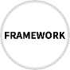


Sample Identify Activities
Identify critical business processes
Document Information flows
Establish policies for cybersecurity that includes roles and responsibilities
Maintain hardware and software inventory
Identify contracts with external partners
Identify Risk Management processes
Business
Environment
[ID.BE]
Asset Management
[ID.AM]
Risk Assessment
[ID.RA]
Governance
[ID.GV]
Notes:
This slide shows some activities that can be performed as part of the foundational Identify Function. Remember, these are sample activities; you’ll find these and more in the NIST framework materials found online at nist.gov/cyberframework, including an excel spreadsheet. You will start to see abbreviations such as ID.BE – this refers to the Function Identify (ID) and BE to “business environment”.
Identify critical business processes—what are the activities that your business does that must continue? This could be maintaining a web site to retrieve payments; or protecting customer/patient information securely; or ensuring that the information your business collects remains accurate. Identify those activities that are essential to your business survival, whether they ensure cash flow or to meet the mission of the business.
Document information flows – It’s important to not only understand what type of information your business collects and uses, but also to have an understanding of where the data is located and flows. Does your business’s critical data stay on internal servers and computers you maintain? Does the data flow to a cloud service provider you have a contract with? Does a managed service provider (MSP) have access to your data or even transfer it offsite? Or do you have a contract with a 3rd-party service provider who receives your information. It’s important to know where data is travelling so that it can be properly protected.
Establish policies for cybersecurity that includes roles and responsibilities – These policies and procedures for cybersecurity should clearly describe your expectations for how cybersecurity activities will protect your information and systems and support critical business processes. Policies and procedures are used to identify acceptable practices and expectations for employees. (NISTIR 7621)
Maintain hardware and software inventory – It’s important to have an understanding of the computers and software in your business because these are frequently the means by which malicious actors will enter into a business. This doesn’t have to be elaborate. For small businesses, it can be a simple spreadsheet with a listing of all the computers, phones, servers, etc., as well as who uses the device and what versions of software are running on each device. Try to set reminders to revisit and update this inventory on a regular basis.
Identify contracts with external partners – Many small businesses have contracts and relationships with external partners. These can include suppliers and/or buyers of both goods and services. Be sure to documents these relationships, including what access they have to your business’s information and computer systems. Do contracts with these external partners stress expectations about service delivery, data protections, access to information and systems, etc.? Also, do any of the critical business processes you identified above depend on services from these providers? If so, are there Service Level Agreements (SLAs) in place with these providers?
Identify Risk Management processes – Be sure to consider and document what is your business’s strategy for managing cybersecurity risk. Does your organization have an existing risk management council that can include cybersecurity risk? If not, consider how your business manages other types of risk (business risk, financial risk, regulatory risk, etc.) and how cybersecurity activities and risks affect those other types of risk. It is important to have executive approval of these plans.
Please note, these sample activities have been updated since the latest revision of NISTIR 7621, so there are differences between these and those published in the NISTIR.
ID.AM Asset Management
ID.BE Business Environment
ID.GV Governance
ID.RA Risk Assessment
ID.RM Risk Management Strategy
ID.SC Supply Chain Risk Management

Slide 36
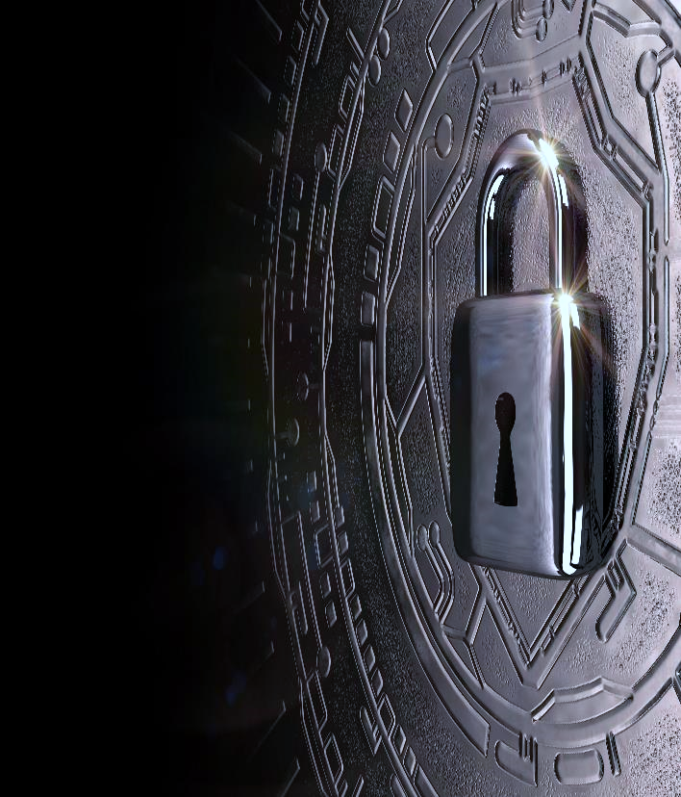



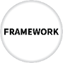


Protect
Develop and implement the appropriate safeguards to ensure delivery of services.
Notes:
Activities in the Protect Function are for ensuring that the critical business processes you identified earlier continue; or that in the event of a disruption can be recovered in a timely manner. In this area of the Framework, you should be looking at processes such as access to the work space (who issues identity credentials and who retrieves them from those who no longer require access); who has a similar role for managing access to your network(s) and services; are you using encryption and/or dual factor authentication methods where available; do you have training for new hires and on a regular basis for your staff; what about your vendors and so forth.

Slide 37



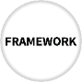


Sample Protect Activities
Information Protection Processes and Procedures
[PR.IP]
Manage access to assets and information
Conduct regular backups
Protect sensitive data
Patch operating systems and applications
Create response and recovery plans
Protect your network
Train your employees
Information Protection Processes and Procedures
[PR.IP]
Maintenance
[PR.MA]
Awareness and Training
[PR.AT]
Identity Management and Access Control
[PR.IP]
Data Security
[PR.DS]
Protective Technology
[PR.PT]
Notes:
Manage access to assets and information – This includes creating unique accounts for each employee so that there is accountability for the actions of users. This also includes ensuring that users only have access to information, computers, and applications that are absolutely needed for their jobs. Even if there are no malicious internal employees, giving an employee too much access or privileges makes it easier for an attacker if that employee’s account or computer is compromised. (NISTIR 7621)
Conduct regular backups – One of the most important activities that you can perform is regular backups. Many operating systems now have built-in backup capabilities, or there are many software solutions you can buy to automate this process. You might only need to connect an external hard drive to your computers and configure the software to start the backups on a regular basis. There are also cloud backup solutions available. Just be aware that it can be good practice to keep one backup of systems offline. This means not connected to the computer while it is powered on. If all the backup hard drives are always connected to the running computer, any malicious software that infects the computer will very likely infect the backup hard drive as well. Offline backup hard drives can be connected to the computer only when you’re ready to conduct the backup. The computer could even be disconnected from the network while the backup completes, and after the external hard drive is removed, the computer could be reconnected to the network. (NISTIR 7621)
Protect sensitive data – identify if your business stores or transmits sensitive data, such as personal information about customers (PII), personal health information (PHI), or financial information. If so, make sure that this data is protected by encryption both while it’s stored on computers as well as when it’s transmitted to other parties. This is why it’s important to understand the data flows within your business and to external parties.
Patch operating systems and applications – vulnerabilities in software is one of the primary ways that adversaries compromise computer systems and gain access to business networks and information. Therefore it’s important to regularly update both the operating system and applications that are installed on your computers and other devices. If possible, enable automatic updates. Otherwise, it might help to set periodic reminders to check for updates. It’s also a good idea to uninstall and software or capabilities that are not necessary for business purposes. (NISTIR 7621)
Create response and recovery plans – It’s important to plan for situations in which critical business processes may be disrupted. What will you do in those cases to ensure that the business keeps operating, even if at a reduced capacity? These plans include Business Continuity and Disaster Recovery. Business Continuity focuses on keeping the business processes operating, even if that involves using manual processes or alternate methods. For example, if a key business process is processing customer submissions through a web portal, are there manual processes that can be done in case the web portal is unavailable. Disaster Recovery plans focus more on planning for disruptions to business due to damages to facilities or damages due to environmental events. It’s important to plan for these scenarios ahead of time to ensure that the business survives. (NISTIR 7621, SP 800-184)
Protect your network – In addition to updating software via patches, there are important considerations for securing the business network. These include installing host-based firewalls and other host-based protections such as endpoint security products. These can block malicious traffic or suspected attacks. If your business utilizes wireless technologies for communication, wireless access points can be secured to ensure that only authorized systems connect to the network and that communications between devices are encrypted and not able to be seen by adversaries. It may also be helpful to consider web and email filters to block users from inadvertently visiting malicious websites or receiving email from malicious actors. (NISTIR 7621, SP 800-153, SP 800-41)
Train your employees – Employees need to understand cybersecurity expectations for protecting the business. Employees should be presented with the company policies on cybersecurity and sign that they understand company policies and understand the related consequences for non compliance. Training should be refreshed on a regular basis. (NISTIR 7621)
--------------------------------------------------
Please note, these sample activities have been updated since the latest revision of NISTIR 7621, so there are differences between these and those published in the NISTIR.
PR.AC Identity Management and Access Control
PR.AT Awareness and Training
PR.DS Data Security
PR.IP Information Protection Processes and Procedures
PR.MA Maintenance
PR.PT Protective Technology

Slide 38
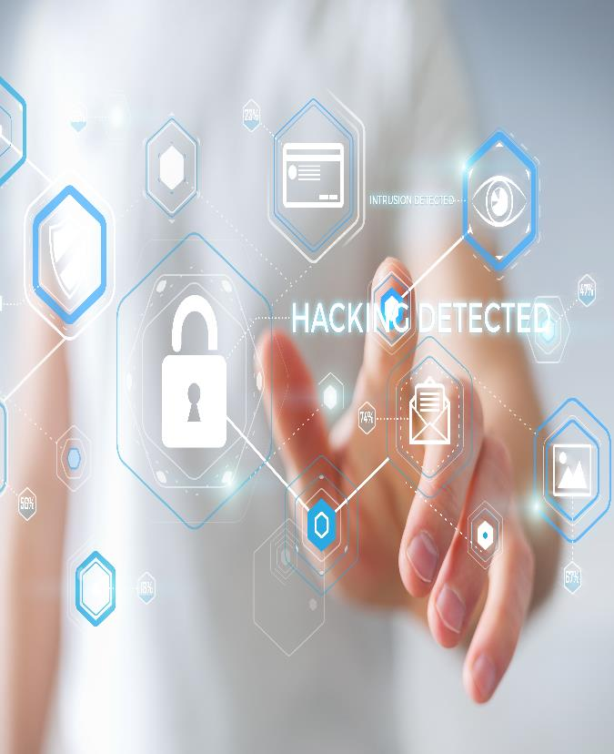
Detect
Develop and implement the appropriate activities to identify the occurrence of a cybersecurity event.
Notes:
Cybersecurity incidents are going to occur. We can’t prevent every attack against our businesses and networks. So we need to make sure we are able to detect when something is not quite right. Too often we think if we’ve installed security software and trained our teams, our work is done. But so much of cybersecurity threats are designed to evade easy detection, so the Detect function sets us up to consider what best practices will enable us to recognize harms and to react appropriately.

Slide 39
Sample Detect Activities
Anomalies and Events
[DE.AE]
Install and update anti-virus and other malware detection software
Know what are expected data flows for your business
Maintain and monitor logs
Continuous Monitoring
[DE.CM]
Notes:
Install and update anti-virus, and other malware detection software – These might come pre-packaged as part of an endpoint security suite from major software vendors. Consider installing these types of endpoint security suites on you business’ computers and laptops. Often these products contain a variety of products bundled together. Enable automatic updates, if possible, if you choose to install any of these products. (NISTIR 7621)
Know what are expected data flows for your business – This builds off of “Document Information Flows” from the Identify Function. If you know what are expected data flows for your business, you are much more likely to notice when unexpected data flows are occurring. These unexpected data flows might include customer information being exported from an internal database and exiting the network. If you have contracted out work to a cloud provider or managed service provider, discuss with them how they track data flows. (NISTIR 7621)
Maintain and monitor logs – It is very difficult to detect unauthorized data flows if logs are not being captured from your business’s applications and computers. These logs record events such as changes to systems or accounts as well as the initiation of communication channels. Consider using Security Information and Event Management (SIEM) software that can aggregate these logs and look for patterns or anomalies from expected network behavior. If you have contracted out work to a cloud provider or managed service provider, consider discussing these types of solutions with them.
Pay attention to other activities that might signal an issue, such as banking activity.

Slide 40




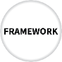


Respond
Develop and implement the appropriate activities to take action regarding a detected cybersecurity event.
Notes:
Once we’ve detected an incident in our business or network, we need to have plans in place to respond to the incident. The incident needs to be contained and mitigated. You and your staff need to know what to do, who has the responsibility and how you will measure your response.

Slide 41
Sample Respond Activities
Coordinate with internal and external stakeholders
Ensure response plans are tested
Ensure response plans are updated
Response Planning
[RS.RP]
Communications
[RS.CO]
Notes:
Coordinate with internal and external stakeholders – It’s important to make sure that your business’s response and recovery plans include all stakeholders and external service providers. For example, it can help to build relationships with local law enforcement before an incident occurs. Having that relationship established ahead of time can make things run smoother when a quick response is needed. Similarly, if your business has purchased a large amount of computers/equipment from a particular vendor, it might help to establish a relationship with support from that vendor. In case disaster strikes, that working relationship can help speed the process of IT systems acquisition when your company needs to get back up and running. (NISTIR 7621; SP 800-184)
Ensure Response plans are tested – It’s good to create plans that include internal and external partners. But it’s even more important to test those plans to make sure each person knows his/her responsibilities in executing the plan(s). The better planned you are, the more effective the response is likely to be. This includes knowing any legal reporting requirements or required information sharing. (NISTIR 7621; SP 800-184)
Ensure Response and Recovery plans are updated – Testing the plan (and execution of the plan(s) during an incident) will reveal needed improvements. Be sure to update the Response and Recovery plans with lessons learned. Were any stakeholders or 3rd parties omitted? Is additional training needed? Is it necessary to incorporate specific scenarios in the testing? Were the communications plans inadequate? (NISTIR 7621; SP 800-184)
RS.RP Response Planning
RS.CO Communications
RS.AN Analysis
RS.MI Mitigation
RS.IM Improvements

Slide 42
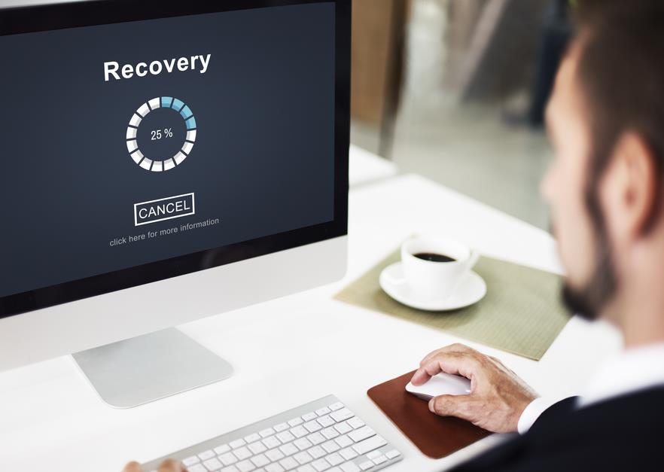
Recover
Develop and implement the appropriate activities to maintain plans for resilience and to restore any capabilities or services that were impaired due to a cybersecurity event.
Notes:
The Recover Function supports timely recovery to normal operations to reduce the impact from a cybersecurity incident. The incident and our response activities may have had an effect on our business operations. Recovery activities help restore those business operations to normal.

Slide 43
Sample Recover Activities
Recovery Planning
[RC.RP]
Manage public relations and company reputation
Communicate with internal and external stakeholders
Ensure recovery plans are updated
Consider cyber insurance
Communications
[RC.CO]
Notes:
Manage public relations and company reputation – One of the key aspects of recovery is managing the company’s reputation. Your business’s reputation is one of its most important assets. Consider in your recovery plans how you will manage public relations so that your information sharing is not reactionary.
Communicate with internal and external stakeholders – Part of managing public relations is effective communication. Your response and recovery plans need to carefully account for how information will be shared with various stakeholders so that all interested parties receive the information they need but no more. Also consider how this information will be shared with stakeholders.
Ensure the Recovery plans are updated - As with Response plans, testing and executing the business’s Recovery plan will highlight areas for improvement. Be sure to update the Recovery plan with these lessons learned. (NISTIR 7621; SP 800-184)
Consider cyber insurance – A growing area of insurance is cyber insurance. You might want to consider exploring how cyber insurance can help in your recovery activities. Be aware, however, that like all insurance, payouts from cyber insurance may take weeks or months. Can your business survive for weeks or months while you await payouts from insurance? If not, be sure to make alternate plans. (NISTIR 7621; SP 800-184)
RC.RP Recovery Planning
RC.IM Improvements
RC.CO Communications

Slide 44
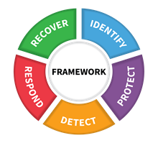
NIST Cybersecurity Framework
Information Protection Processes and Procedures
[PR.IP]
Maintenance
[PR.MA]
Communications
[RS.CO]
Identity Management and Access Control
[PR.IP]
Anomalies and Events
[DE.AE]
Recovery Planning
[RC.RP]
Asset Management
[ID.AM]
Awareness and Training
[PR.AT]
Response Planning
[RS.RP]
Governance
[ID.GV]
Protective Technology
[PR.PT]
Continuous Monitoring
[DE.CM]
Risk Assessment
[ID.RA]
Communications
[RC.CO]
Data Security
[PR.DS]
Business
Environment
[ID.BE]
Notes:
The NIST Cybersecurity Framework is rooted in practical and time-tested business logic and can work for you; if you adopt the principles and do the work. There are more resources to help you understand these concepts and the steps you will want to take on the NIST Cybersecurity Framework website. Additionally, there are organizations such as your local Small Business Development Center and the National Cyber Security Alliance who can assist you. Other resources will be listed at the end.

Slide 45

Everyday Tips
Be careful of email attachments, web links and voice calls from unknown numbers.
Do not click on a link or open an attachment that you were not expecting.
Use separate personal and business computers, mobile devices, and accounts.
Use multi-factor authentication where offered.
Do not download software from an unknown web page.
Never give out your username or password.
Consider using a password management application to store your passwords for you.
More
NIST Interagency Report 7621, revision 1
Small Business Information Security: The Fundamentals, section 4
Notes:
https://doi.org/10.6028/NIST.IR.7621r1

Slide 46
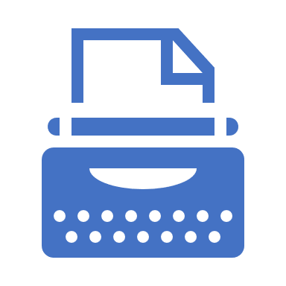
Need Help?
You might choose to outsource some of your security needs.
Ask for recommendations from business partners, local Chamber of Commerce, Better Business Bureau, colleges or universities.
Request quotes and have a clear list of actions or outcomes that you want to achieve.
Check past performance using reviews posted online. Check for Better Business Bureau or Federal Trade Commission complaints.
Find out who will be doing the work and ask for their qualifications.
More
NIST Interagency Report 7621, revision 1
Small Business Information Security: The Fundamentals, section 2.3
Notes:
Numerous organizations, federal, state, local and private, are able to help you with your cybersecurity planning and preparedness. You may also find a cybersecurity vendor from your local FBI Infragard, a community-based information sharing effort where information is shared about physical and cybersecurity threats .
https://doi.org/10.6028/NIST.IR.7621r1

Slide 47
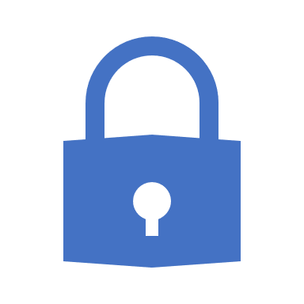
Resources
NIST Small Business Cybersecurity Corner
https://www.nist.gov/itl/smallbusinesscyber
CyberSecure My Business | National Cyber Security Alliance
https://staysafeonline.org/cybersecure-business/
NIST Interagency Report 7621, revision 1 | Small Business Information Security: The Fundamentals
https://doi.org/10.6028/NIST.IR.7621r1
Notes:
Please also visit the websites of Federal Agencies such as: the Federal Trade Commission (https://www.ftc.gov/tips-advice/business-center/small-businesses), the Small Business Administration (SBA.gov), Department of Homeland Security (https://www.dhs.gov/publication/stopthinkconnect-small-business-resources).
NIST Special Publication “Managing Information Risk: Organization, Mission and Information System View,” in particular the “FARM” (Frame, Assess, Respond and Monitor) process from 800-39 for decision-making.
https://doi.org/10.6028/NIST.SP.800-39
MEP Cybersecurity Assessment Tool from NIST’s Manufacturing Exchange Partnership National Network: https://www.surveymonkey.com/r/Z7RVFWV

Slide 48
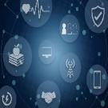
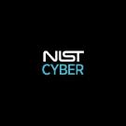


More Information
More Information
https://www.nist.gov/itl/smallbusinesscyber
www.NIST.gov/topics/cybersecurity
@NISTcyber
smallbizsecurity@nist.gov

